Slide 1
Transaction Concept
A transaction is a unit of program execution that accesses and possibly updates various data items.
E.g., transaction to transfer $50 from account A to account B:
  1. read(A)
  2. A := A – 50
  3. write(A)
  4. read(B)
  5. B := B + 50
  6. write(B)
Two main issues to deal with:
  Failures of various kinds, such as hardware failures and system crashes
  Concurrent execution of multiple transactions

Slide 2
Required Properties of a Transaction
Consider a transaction to transfer $50 from account A to account B:
  1. read(A)
  2. A := A – 50
  3. write(A)
  4. read(B)
  5. B := B + 50
  6. write(B)
Atomicity requirement
  If the transaction fails after step 3 and before step 6, money will be “lost” leading to an inconsistent database state
    Failure could be due to software or hardware
  The system should ensure that updates of a partially executed transaction are not reflected in the database
Durability requirement — once the user has been notified that the transaction has completed (i.e., the transfer of the $50 has taken place), the updates to the database by the transaction must persist even if there are software or hardware failures.

Slide 3
Required Properties of a Transaction (Cont.)
Consistency requirement in above example:
A transaction, when starting to execute, must see a consistent database.
During transaction execution the database may be temporarily inconsistent.
When the transaction completes successfully the database must be consistent
  Erroneous transaction logic can lead to inconsistency

Slide 4
Required Properties of a Transaction (Cont.)
Isolation requirement — if between steps 3 and 6 (of the fund transfer transaction) , another transaction T2 is allowed to access the partially updated database, it will see an inconsistent database (the sum A + B will be less than it should be).
T1 T2
  1. read(A)
  2. A := A – 50
  3. write(A)
  read(A), read(B), print(A+B)
  4. read(B)
  5. B := B + 50
  6. write(B
Isolation can be ensured trivially by running transactions serially
  That is, one after the other.
However, executing multiple transactions concurrently has significant benefits, as we will see later.

Slide 5
ACID Properties
A transaction is a unit of program execution that accesses and possibly updates various data items. To preserve the integrity of data the database system must ensure:
Atomicity. Either all operations of the transaction are properly reflected in the database or none are.
Consistency. Execution of a transaction in isolation preserves the consistency of the database.
Isolation. Although multiple transactions may execute concurrently, each transaction must be unaware of other concurrently executing transactions. Intermediate transaction results must be hidden from other concurrently executed transactions.
  That is, for every pair of transactions T_{i} and T_{j}, it appears to T_{i} that either T_{j}, finished execution before T_{i} started, or T_{j} started execution after T_{i} finished.
Durability. After a transaction completes successfully, the changes it has made to the database persist, even if there are system failures.

Slide 6
Transaction State
Active – the initial state; the transaction stays in this state while it is executing
Partially committed – after the final statement has been executed.
Failed -- after the discovery that normal execution can no longer proceed.
Aborted – after the transaction has been rolled back and the database restored to its state prior to the start of the transaction. Two options after it has been aborted:
  Restart the transaction
    can be done only if no internal logical error
  Kill the transaction
Committed – after successful completion.

Slide 7

Transaction State (Cont.)

Slide 8
Concurrent Executions
Multiple transactions are allowed to run concurrently in the system. Advantages are:
  Increased processor and disk utilization, leading to better transaction throughput
    E.g. one transaction can be using the CPU while another is reading from or writing to the disk
  Reduced average response time for transactions: short transactions need not wait behind long ones.
Concurrency control schemes – mechanisms to achieve isolation
  That is, to control the interaction among the concurrent transactions in order to prevent them from destroying the consistency of the database
    Will study in Chapter 15, after studying notion of correctness of concurrent executions.

Slide 9
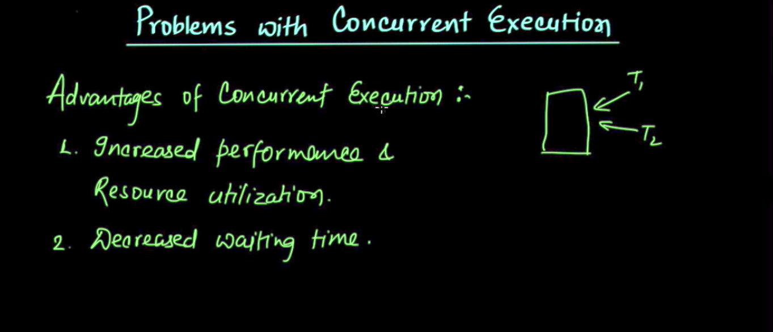


Slide 10
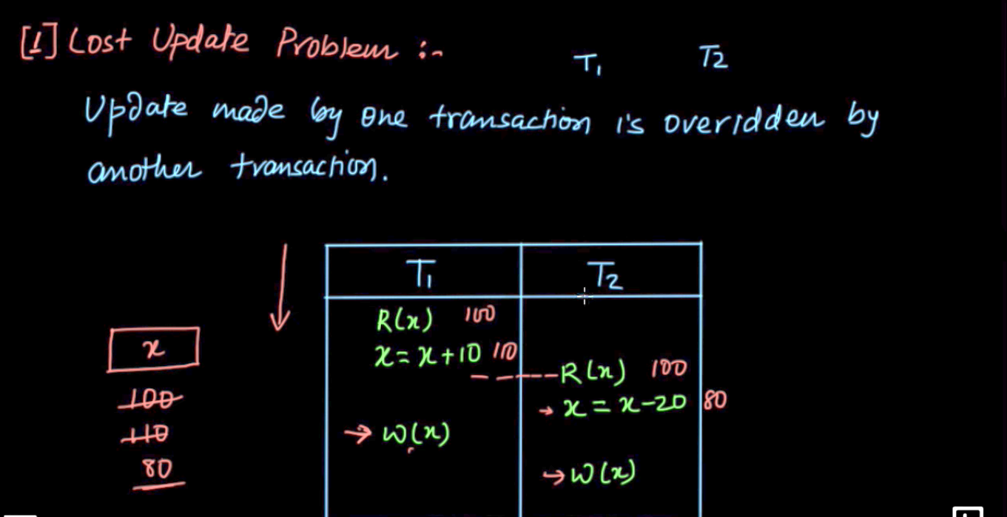

Slide 11
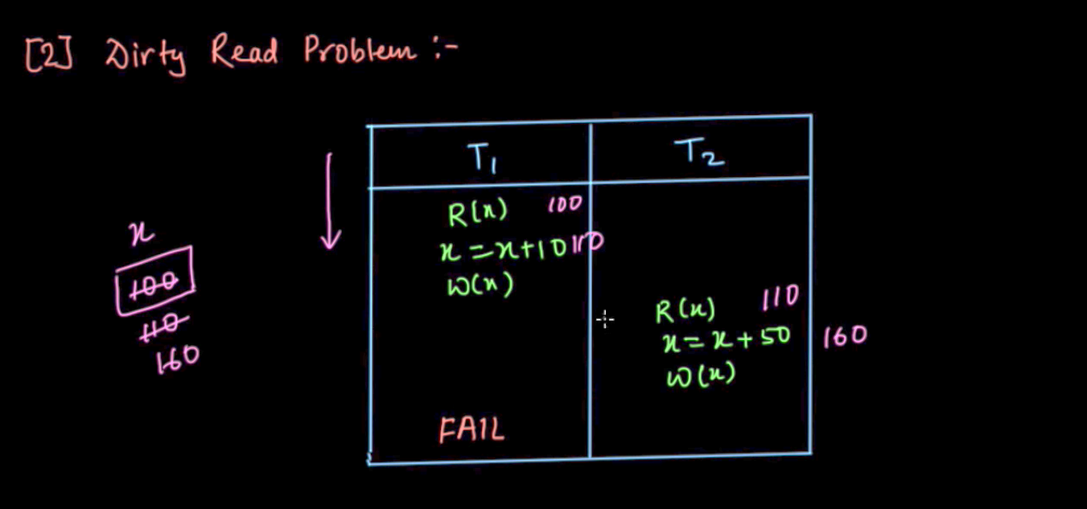

Slide 12
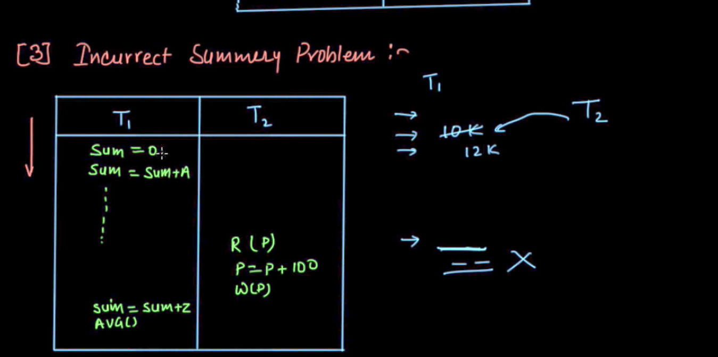

Slide 13
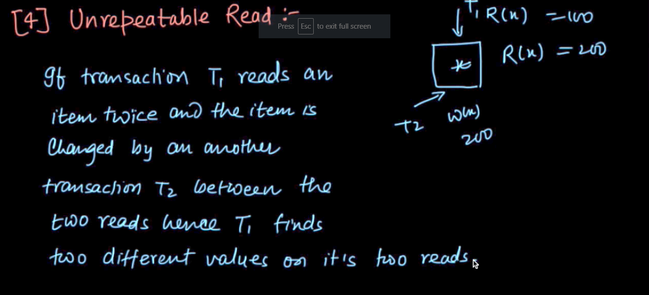

Slide 14
Schedules
Schedule – a sequences of instructions that specify the chronological order in which instructions of concurrent transactions are executed
  A schedule for a set of transactions must consist of all instructions of those transactions
  Must preserve the order in which the instructions appear in each individual transaction.
A transaction that successfully completes its execution will have a commit instructions as the last statement
  By default transaction assumed to execute commit instruction as its last step
A transaction that fails to successfully complete its execution will have an abort instruction as the last statement

Slide 15
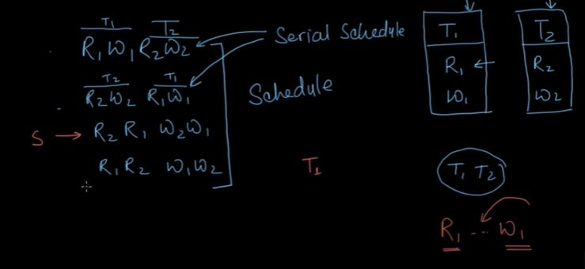

Slide 16
Conflict Operations
Operations belonging to different transaction.
Operations must access the same data item.
At least one of the operation should be write.

Slide 17
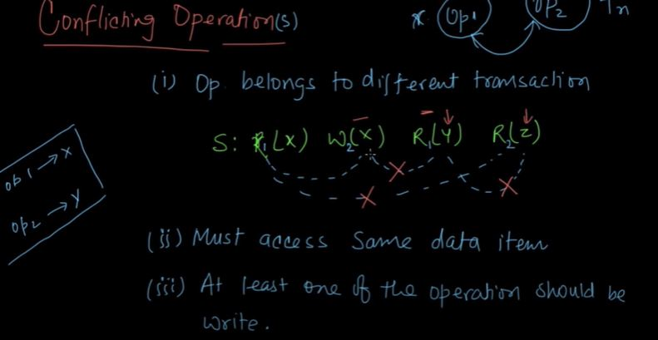

Slide 18
Serializability
Basic Assumption – Each transaction preserves database consistency.
Thus, serial execution of a set of transactions preserves database consistency.
A (possibly concurrent) schedule is serializable if it is equivalent to a serial schedule. Different forms of schedule equivalence give rise to the notions of:
  1. conflict serializability
  2. view serializability

Slide 19
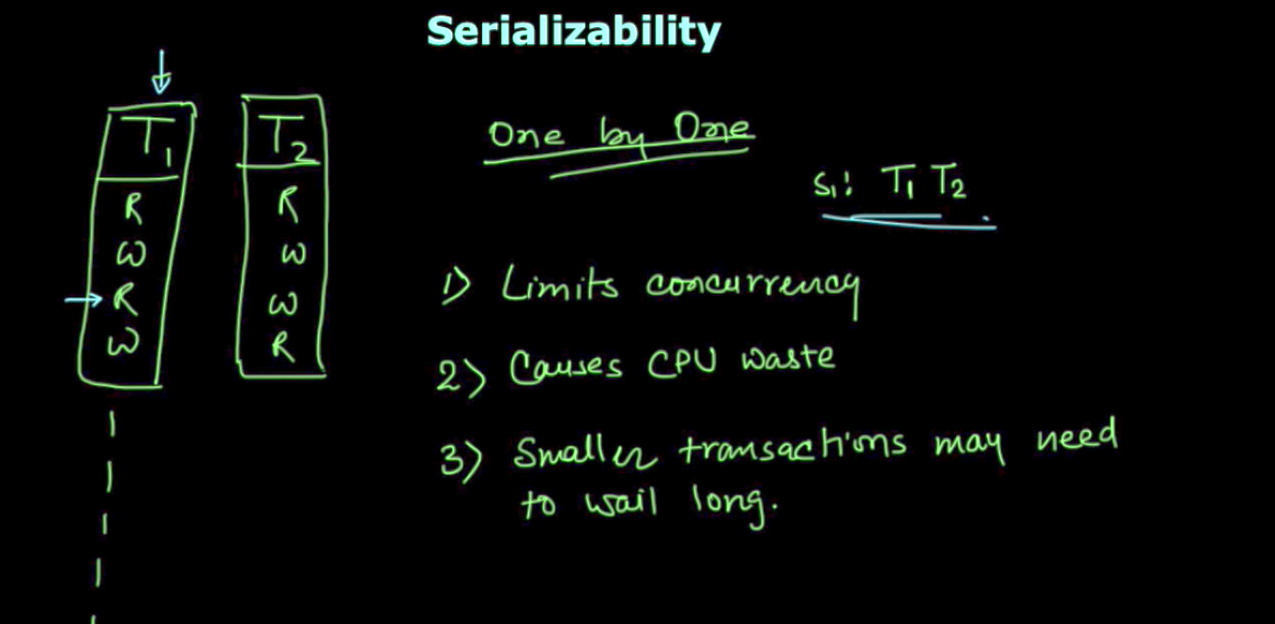

Slide 20
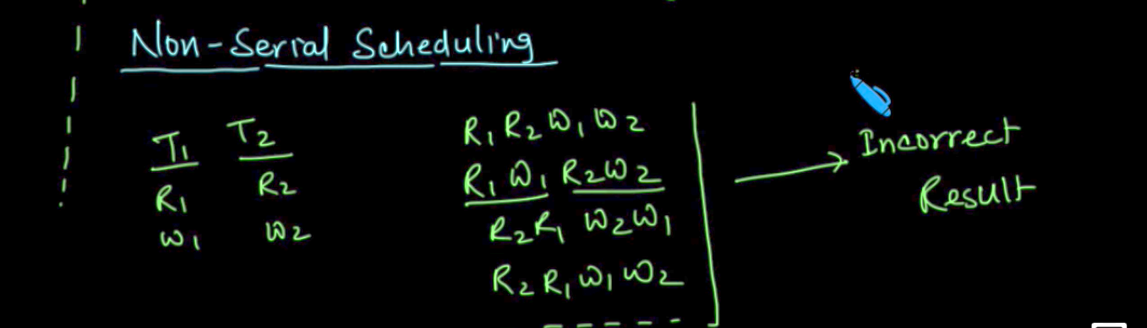

Slide 21
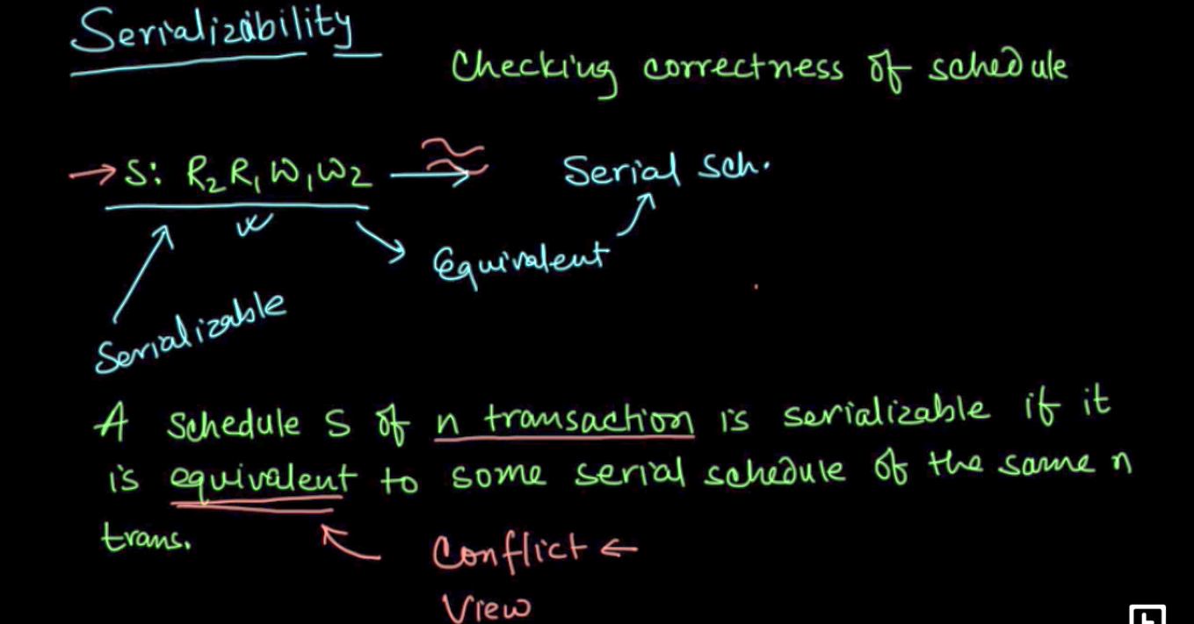

Slide 22
Simplified view of transactions
We ignore operations other than read and write instructions
We assume that transactions may perform arbitrary computations on data in local buffers in between reads and writes.
Our simplified schedules consist of only read and write instructions.

Slide 23
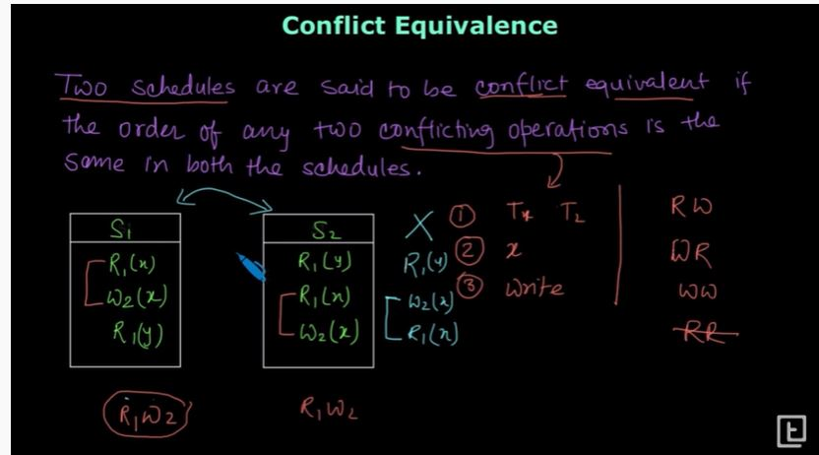

Slide 24
Conflicting Instructions
Let l_{i} and l_{j} be two Instructions of transactions T_{i} and T_{j} respectively. Instructions l_{i} and l_{j} conflict if and only if there exists some item Q accessed by both l_{i} and l_{j}, and at least one of these instructions wrote Q.
1. l_{i} = read(Q), l_{j} = read(Q). l_{i} and l_{j} don’t conflict.
2. l_{i} = read(Q), l_{j} = write(Q). They conflict.
3. l_{i} = write(Q), l_{j} = read(Q). They conflict
4. l_{i} = write(Q), l_{j} = write(Q). They conflict
Intuitively, a conflict between l_{i} and l_{j} forces a (logical) temporal order between them.
  If l_{i} and l_{j} are consecutive in a schedule and they do not conflict, their results would remain the same even if they had been interchanged in the schedule.

Slide 25
Conflict Serializability
If a schedule S can be transformed into a schedule S´ by a series of swaps of non-conflicting instructions, we say that S and S´ are conflict equivalent.
We say that a schedule S is conflict serializable if it is conflict equivalent to a serial schedule

Slide 26
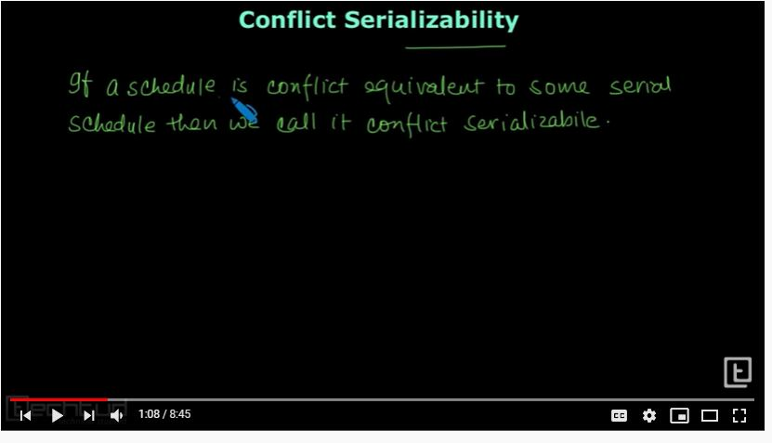

Slide 27
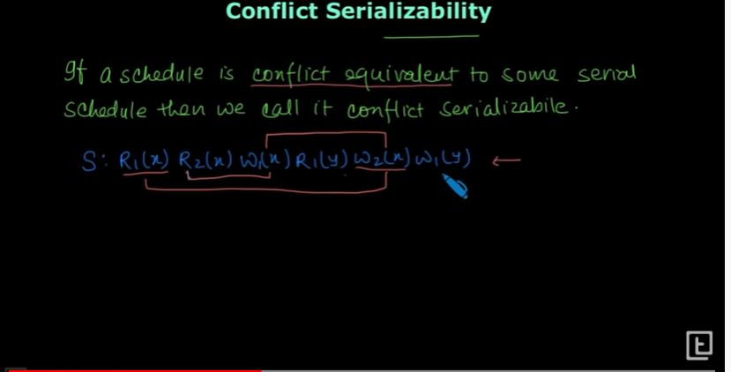

Slide 28
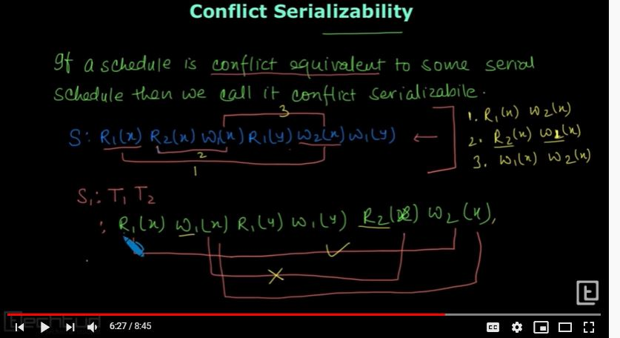

Slide 29
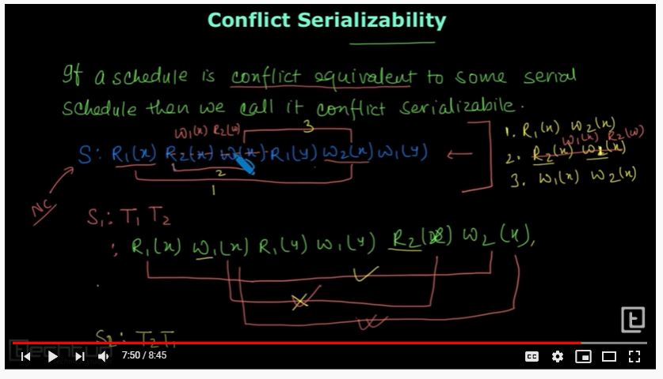

Slide 30

Precedence Graph
Consider some schedule of a set of transactions T₁, T₂, ..., T_{n}
Precedence graph — a direct graph where the vertices are the transactions (names).
We draw an arc from T_{i} to T_{j} if the two transaction conflict, and T_{i} accessed the data item on which the conflict arose earlier.
We may label the arc by the item that was accessed.
Example

Slide 31
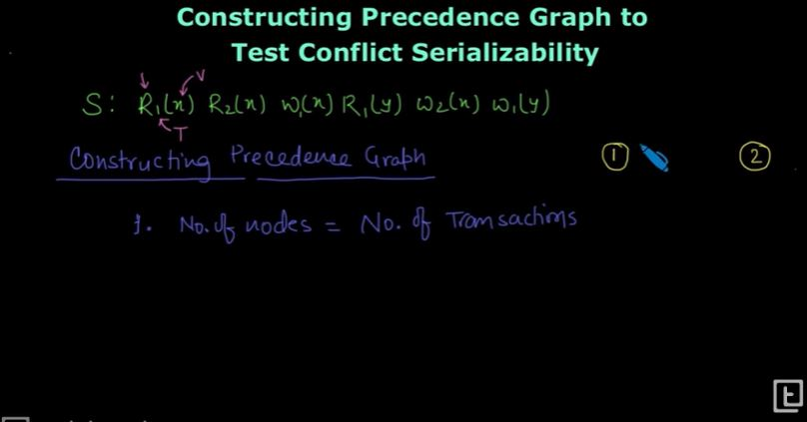

Slide 32
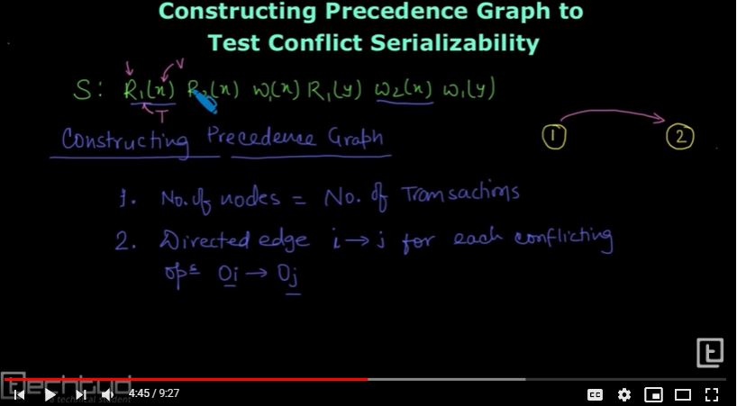

Slide 33
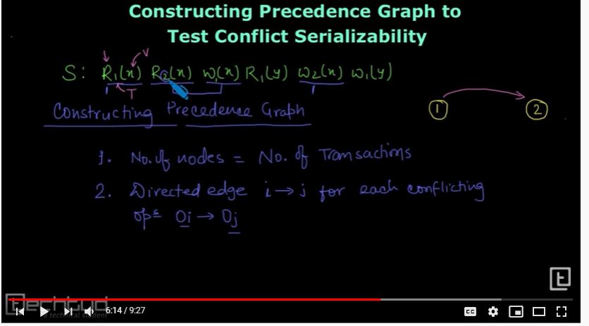

Slide 34
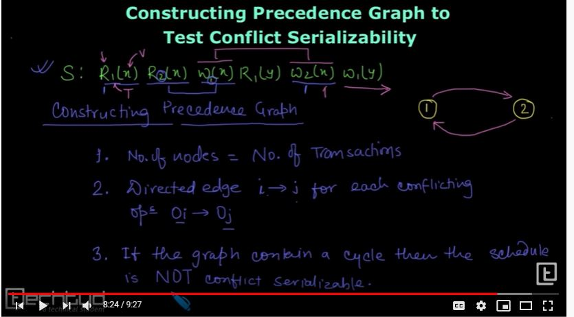

Slide 35
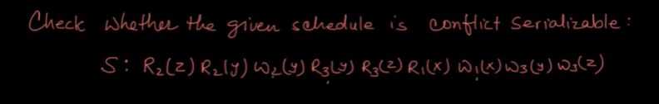

Slide 36
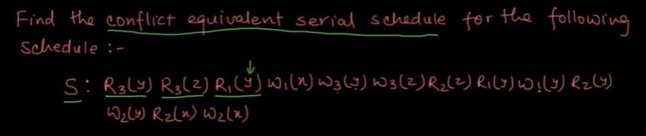

Slide 37

Testing for Conflict Serializability
A schedule is conflict serializable if and only if its precedence graph is acyclic.
Cycle-detection algorithms exist which take order n² time, where n is the number of vertices in the graph.
  (Better algorithms take order n + e where e is the number of edges.)
If precedence graph is acyclic, the serializability order can be obtained by a topological sorting of the graph.
  That is, a linear order consistent with the partial order of the graph.
  For example, a serializability order for the schedule (a) would be one of either (b) or (c)

Slide 38

Recoverable Schedules
Recoverable schedule — if a transaction T_{j} reads a data item previously written by a transaction T_{i} , then the commit operation of T_{i} must appear before the commit operation of T_{j}.
The following schedule is not recoverable if T₉ commits immediately after the read(A) operation.
If T₈ should abort, T₉ would have read (and possibly shown to the user) an inconsistent database state. Hence, database must ensure that schedules are recoverable.

Slide 39
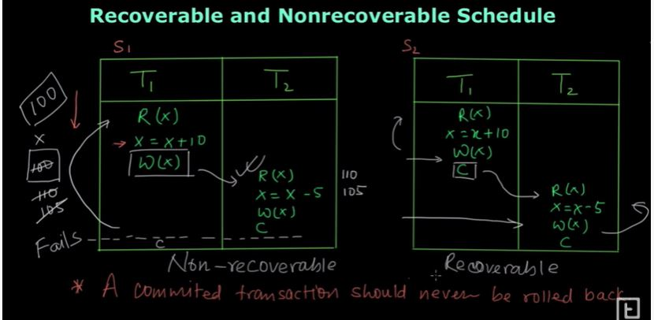

Slide 40

Cascading Rollbacks
Cascading rollback – a single transaction failure leads to a series of transaction rollbacks. Consider the following schedule where none of the transactions has yet committed (so the schedule is recoverable)
If T₁₀ fails, T₁₁ and T₁₂ must also be rolled back.
Can lead to the undoing of a significant amount of work

Slide 41
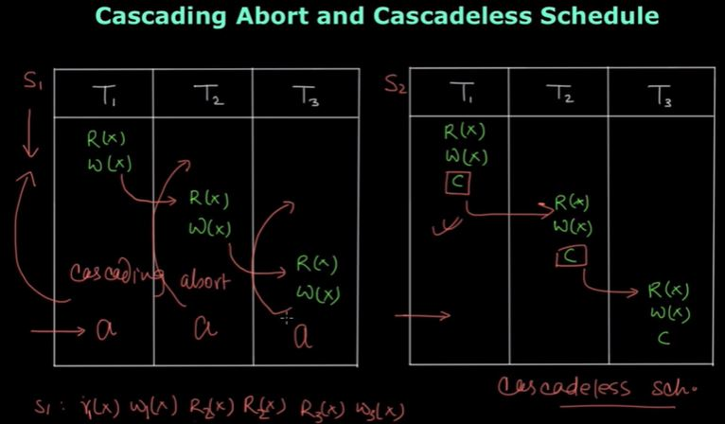

Slide 42
Cascadeless Schedules
Cascadeless schedules — for each pair of transactions T_{i} and T_{j} such that T_{j} reads a data item previously written by T_{i}, the commit operation of T_{i} appears before the read operation of T_{j}.
Every cascadeless schedule is also recoverable
It is desirable to restrict the schedules to those that are cascadeless
Example of a schedule that is NOT cascadeless

Slide 43
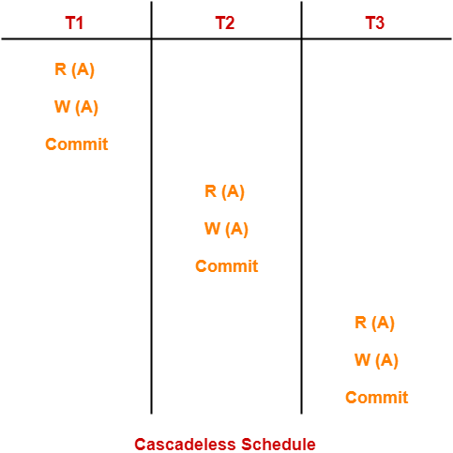

Slide 44
Concurrency Control
A database must provide a mechanism that will ensure that all possible schedules are both:
  Conflict serializable.
  Recoverable and preferably cascadeless
A policy in which only one transaction can execute at a time generates serial schedules, but provides a poor degree of concurrency
Concurrency-control schemes tradeoff between the amount of concurrency they allow and the amount of overhead that they incur
Testing a schedule for serializability after it has executed is a little too late!
  Tests for serializability help us understand why a concurrency control protocol is correct
Goal – to develop concurrency control protocols that will assure serializability.

Slide 45
View Serializability
Let S and S´ be two schedules with the same set of transactions. S and S´ are view equivalent if the following three conditions are met, for each data item Q,
  If in schedule S, transaction T_{i} reads the initial value of Q, then in schedule S’ also transaction T_{i} must read the initial value of Q.
  If in schedule S transaction T_{i} executes read(Q), and that value was produced by transaction T_{j} (if any), then in schedule S’ also transaction T_{i} must read the value of Q that was produced by the same write(Q) operation of transaction T_{j} .
  The transaction (if any) that performs the final write(Q) operation in schedule S must also perform the final write(Q) operation in schedule S’.
As can be seen, view equivalence is also based purely on reads and writes alone.

Slide 46

View Serializability (Cont.)
A schedule S is view serializable if it is view equivalent to a serial schedule.
Every conflict serializable schedule is also view serializable.
Below is a schedule which is view-serializable but not conflict serializable.
What serial schedule is above equivalent to?
Every view serializable schedule that is not conflict serializable has blind writes.

Slide 47
Test for View Serializability
The precedence graph test for conflict serializability cannot be used directly to test for view serializability.
  Extension to test for view serializability has cost exponential in the size of the precedence graph.
The problem of checking if a schedule is view serializable falls in the class of NP-complete problems.
  Thus, existence of an efficient algorithm is extremely unlikely.
However ,practical algorithms that just check some sufficient conditions for view serializability can still be used.

Slide 48
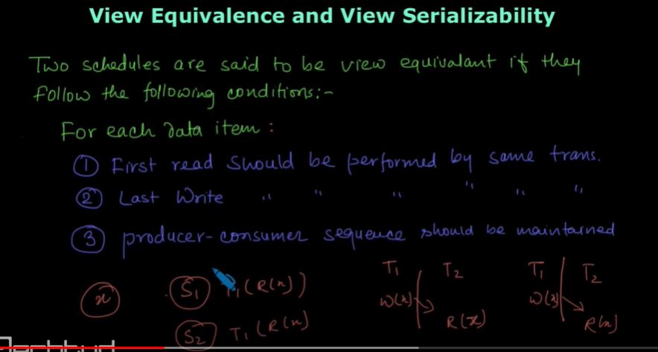

Slide 49
